Slide 1
Lab 09 Using Databases
By
M.Zakir Khan

Slide 2
User-entered data needs to be saved somewhere so that it can be accessed at a later time. Android offers the SQLite relational database library for persisting data. It’s an open-source, lightweight and powerful database available in the form of C library. It uses SQL for storing and retrieving information and performing database maintenance. SQLite is extremely reliable and is popularly used in devices with restricted computing power. Through SQLite, we can create individual databases for each application and store and manage application-related data.

Slide 3
Using the SQLiteOpenHelper class. To create an Android application that stores, accesses and manipulates user information in a SQLite-relational database, we use the SQLiteOpenHelper class. The SQLiteOpenHelper class is an abstract class that provides a way to get read or write access to a database. The SQLiteOpenHelper class are used to create,open and upgrade database. It provide several methods including getWritableDatabase(), getReadableDatabase() and close().

Slide 4
Additional Information SQLite is an Open Source database SQLite supports standard relational database features. Android comes in with built in SQLite database implementation. To create and upgrade a database in your Android application you create a subclass of the SQLiteOpenHelper class. In the constructor of your subclass you call the super() method of the SQLiteOpenHelper.

Slide 5
Steps to be remember
Normally two ways to make a database…
Internal and external creation of database
In android for database creation, we make a separate class and then extend it form SQLiteOpenHelper and implements their 2 methods and also make constructor.
Write a query of creation of table in onCreate method
We can work in the same databasehelper class but make a separate class for CRUD (Creation,Retrieve,Updation and deletion ) operation to be better management.
Make a separate class like any meaning name
Whenever we insert a value then we will use ContentValue class
Whenever we want to show the data then we will use Cursor class and rawQuery();

Slide 6
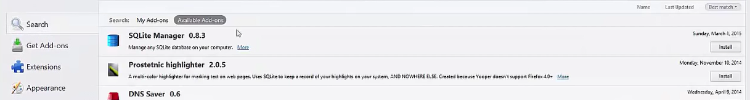
Student Database path
If you want to check the database creation where exist or not then
Goto Tools→Android→AndroidDeviceMonitor and then click
On left side check your App name and then click on it
On right side click on data→data→searchAppName then click on database→
If you have firefox browser it will help you more in sqliteManager
Go to adds-on icon and then search sqliteManager and then install it and enjoy it.

Slide 7
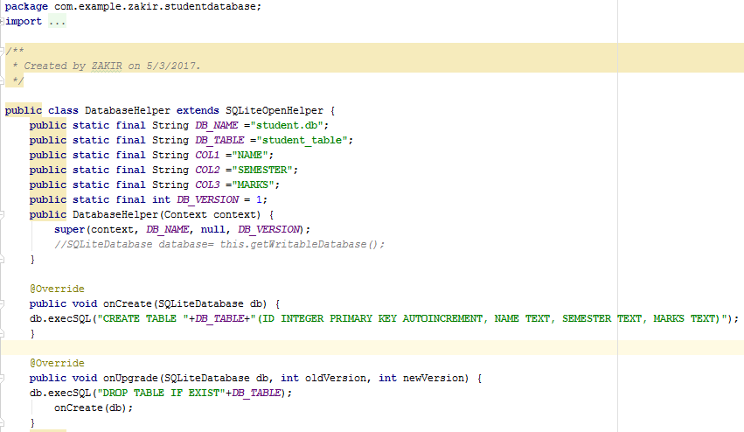
Step1
First of all make a separate class for Managing database like name here is DatabaseHelper or anyName

Slide 8
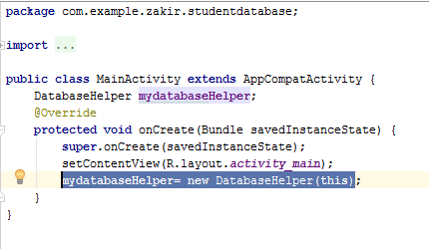
Step2
Call the name of the DatabaseHelper and register it in MainActivity like and then run it and check whether the database is created or not?

Slide 9
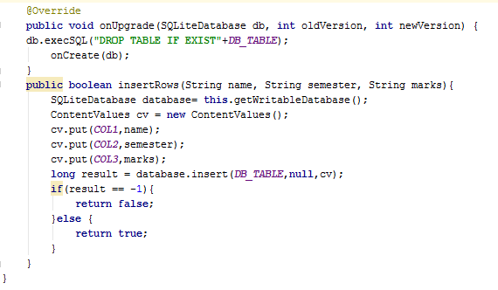
Step3
Make a function of Insertion in DatabaseHelper class and use of ContentValues

Slide 10
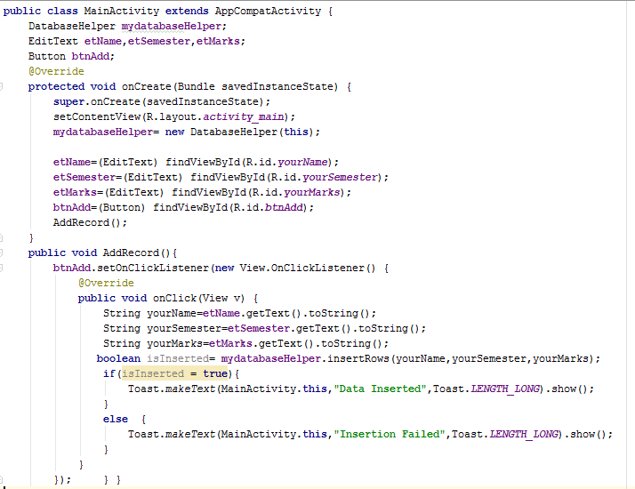
Step4
Make the following changes in MainActivity

Slide 11
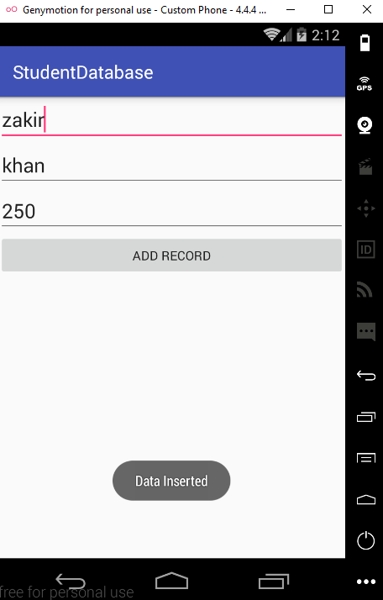
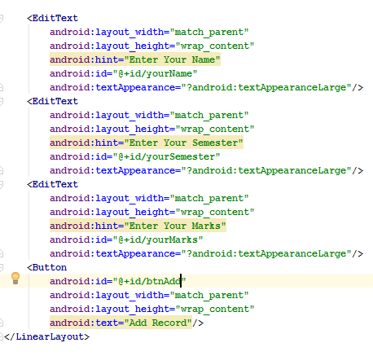
Step5
Make a GUI part

Slide 12
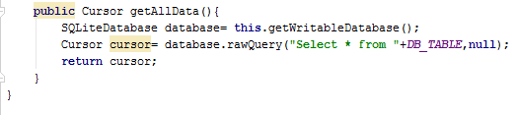
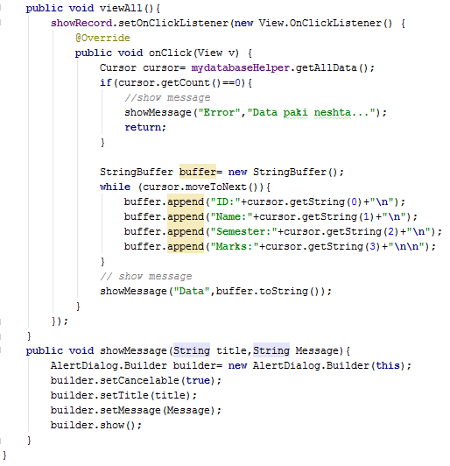
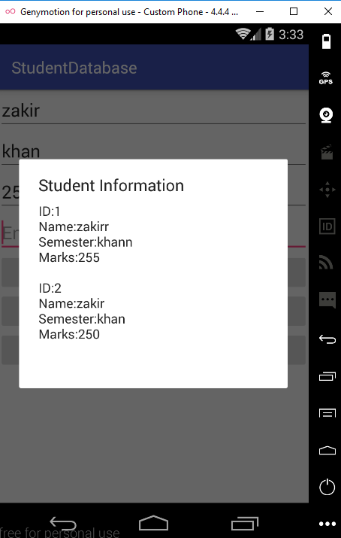
Now add others methods in DatabaseHelper and add it in MainActivity

Slide 13
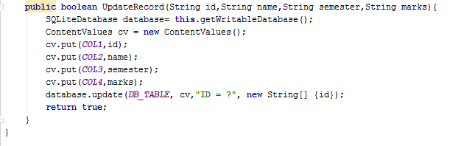
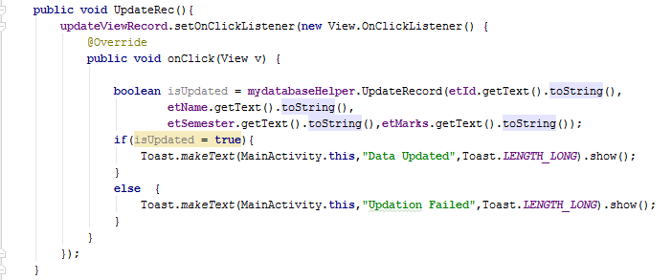
Now add others methods in DatabaseHelper and add it in MainActivity

Slide 14
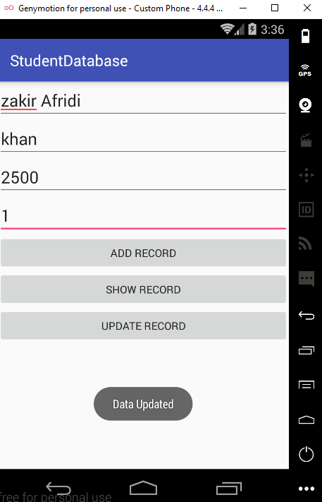
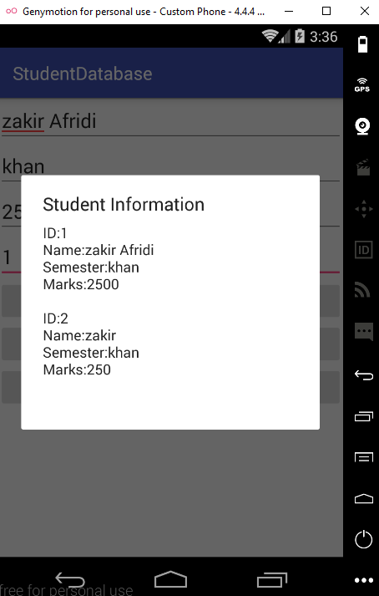
Now Want Updation of Record 01

Slide 15
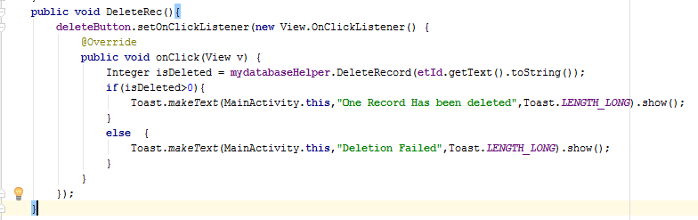

Now add others methods in DatabaseHelper and add it in MainActivity

Slide 16
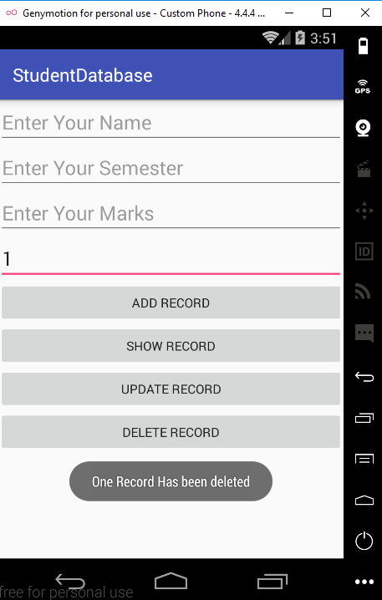
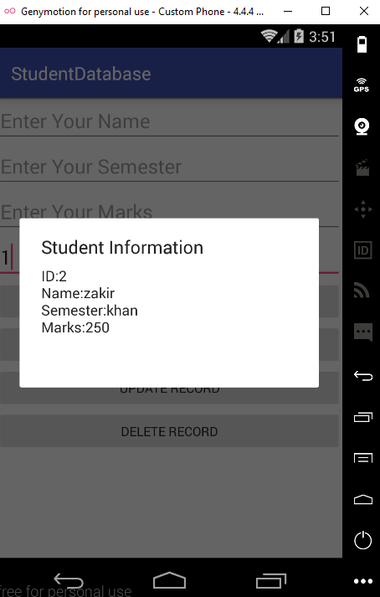
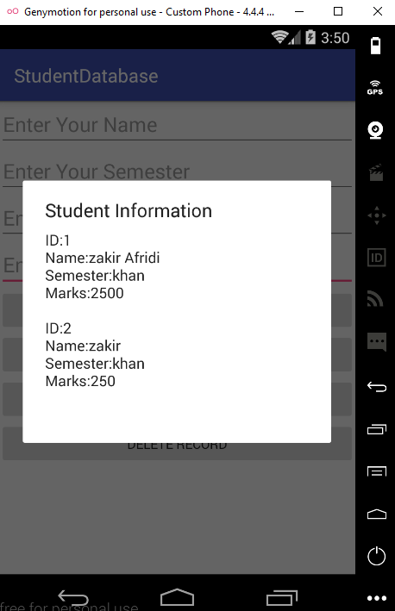
Screen shot

Slide 17
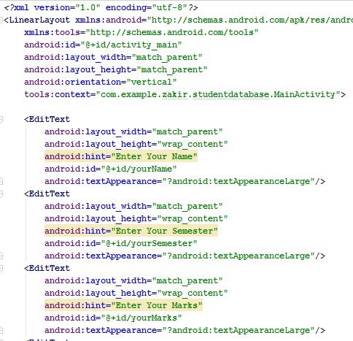
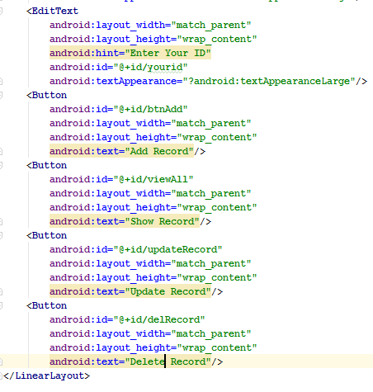
Complete OverView

Slide 18
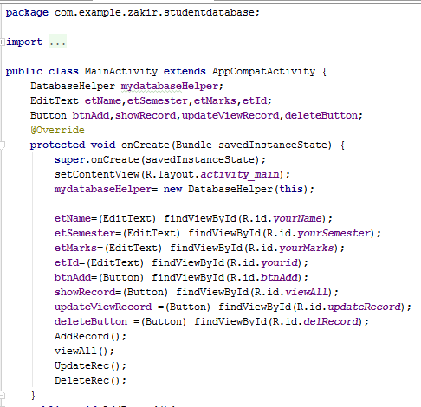
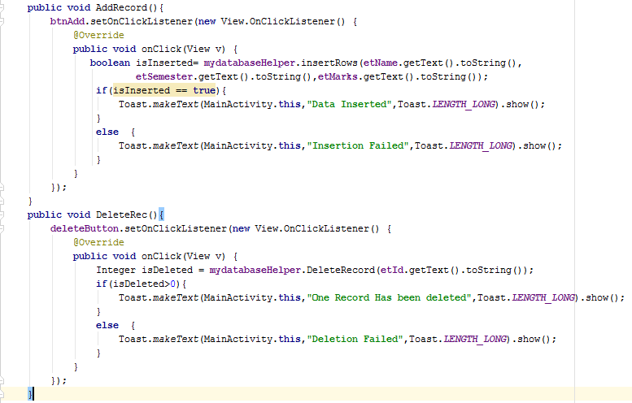
Complete OverView

Slide 19
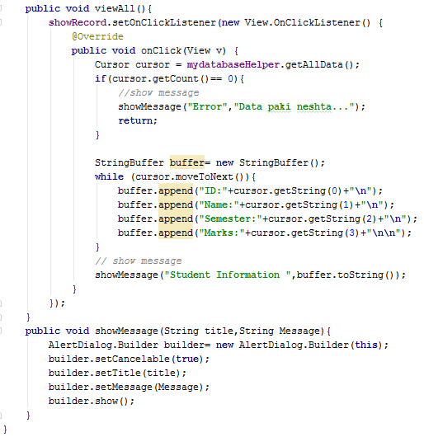
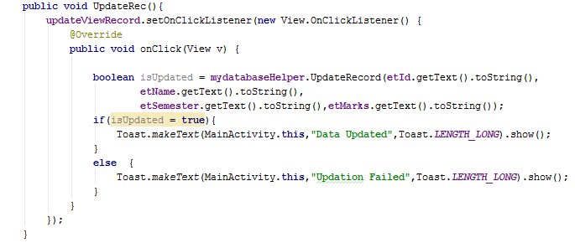
Complete OverView

Slide 20
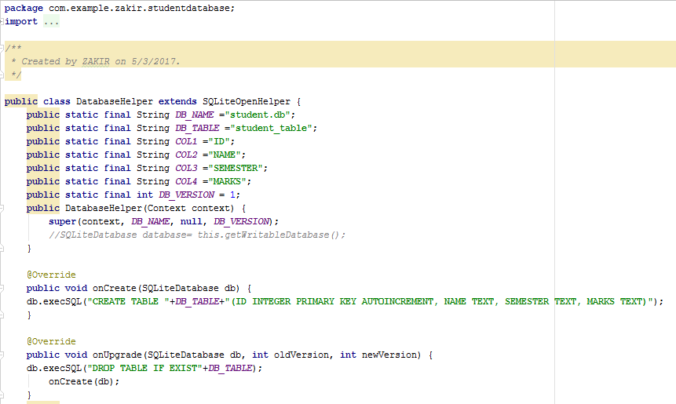
Complete OverView

Slide 21
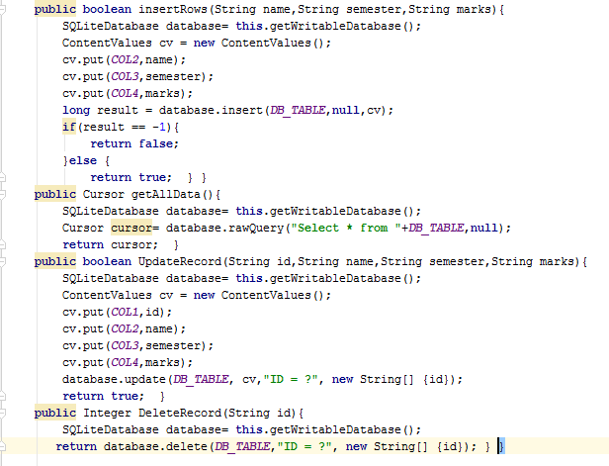
Complete OverView

Slide 22
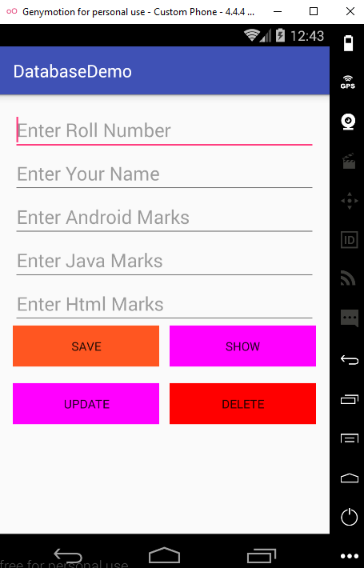
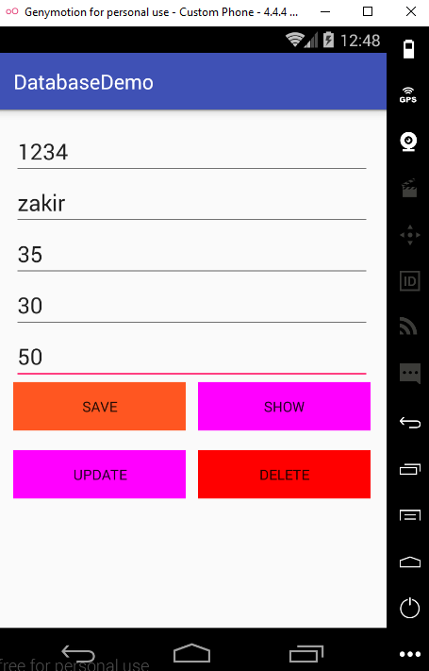
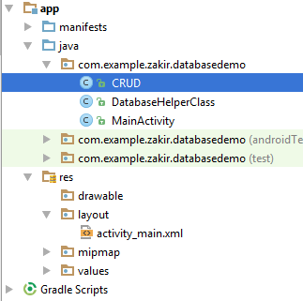
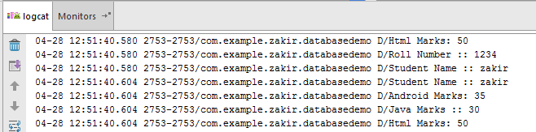
Screen shot Example 2 using Log

Slide 23
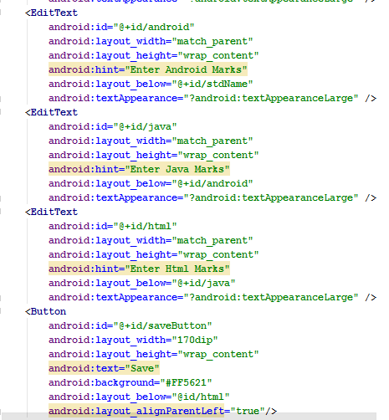
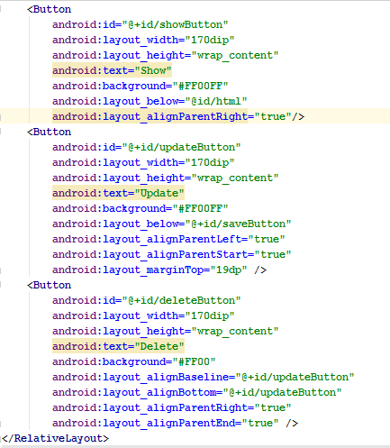
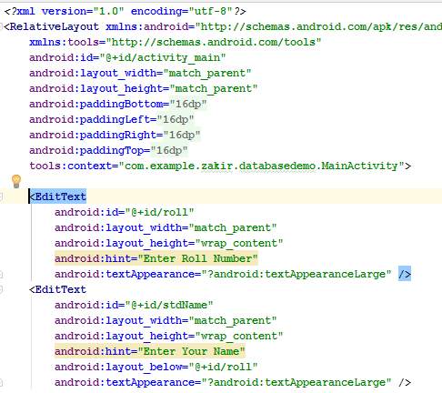
XML

Slide 24
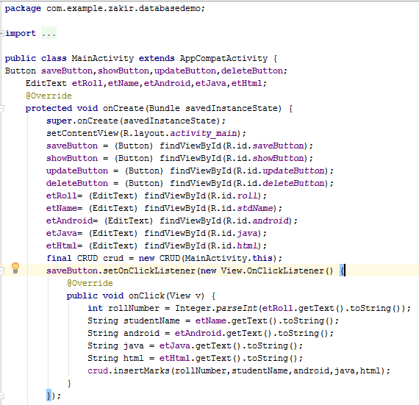
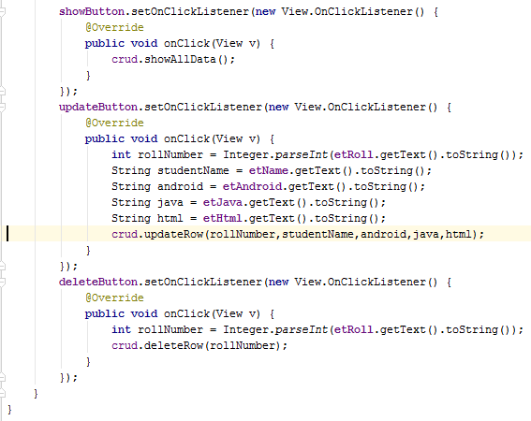
MainActivity Java Code

Slide 25
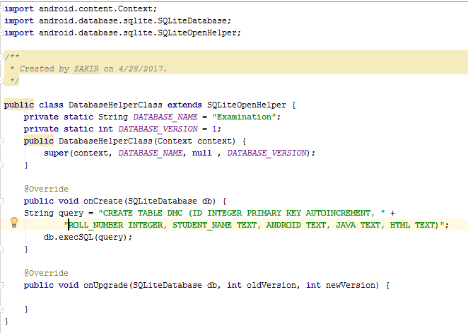
Java code of DatabaseHelper class

Slide 26
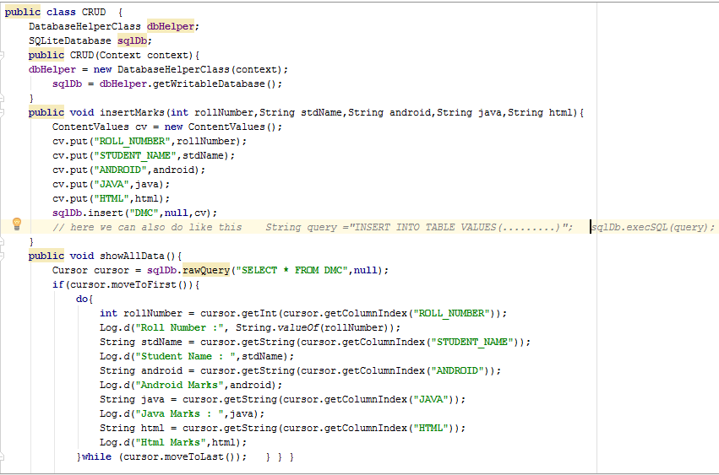
Java code of CRUD class

Slide 27
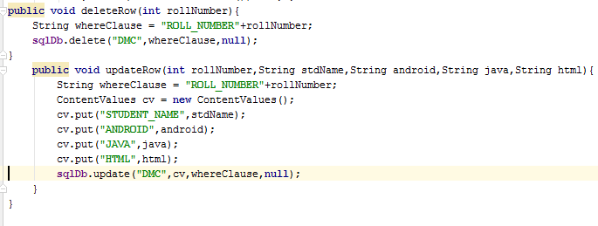
Java code of CRUD class continue

Slide 28
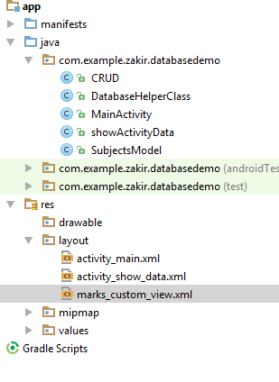
Show the data in Listview instead of Log

Slide 29
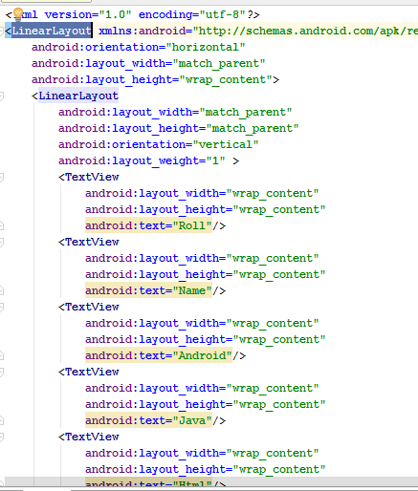
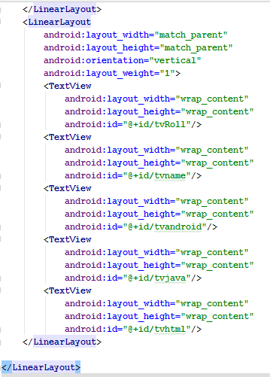
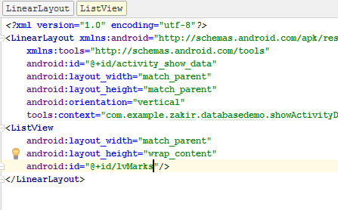
XML activity_show_data +mark_custom_view code

Slide 30
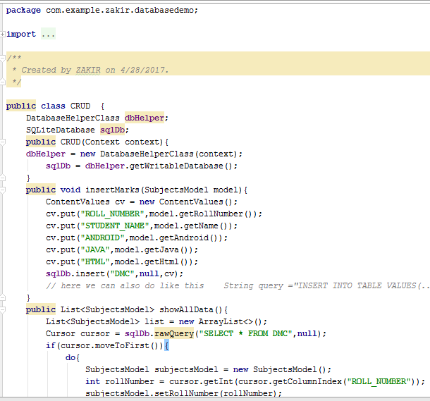
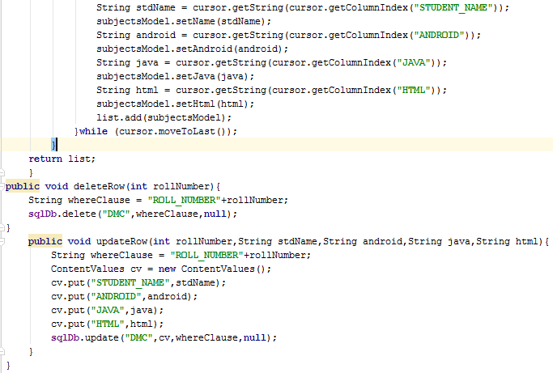
CRUD.java

Slide 31
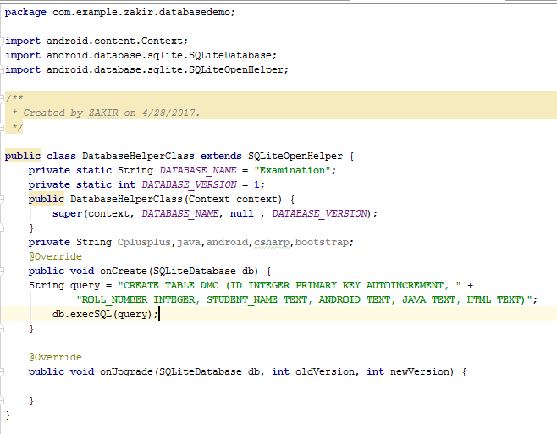
DatabaseHelperClass java code

Slide 32
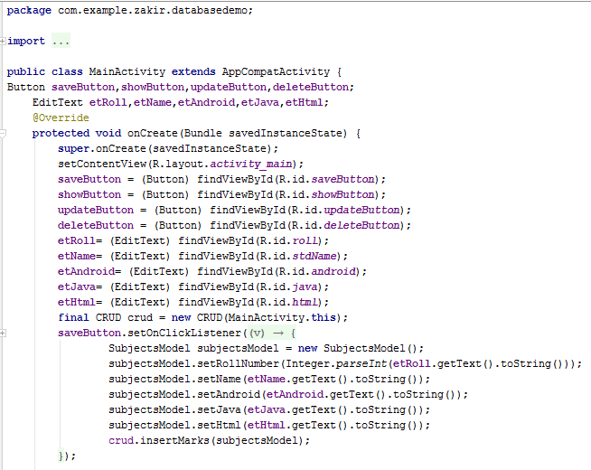
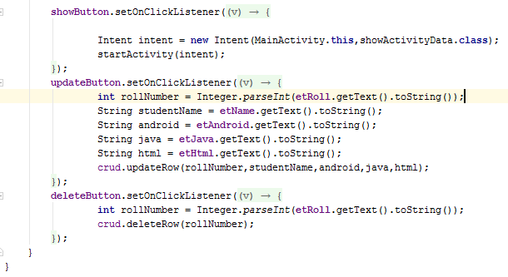
MainActivity

Slide 33
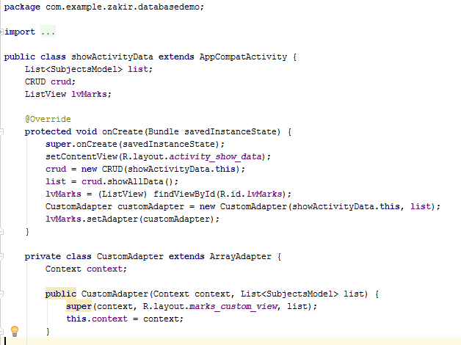
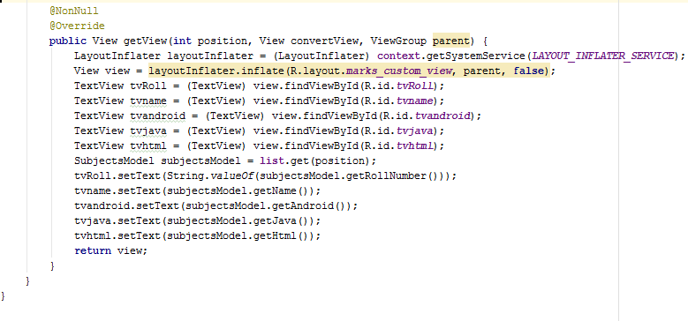
Show Activity Data

Slide 34
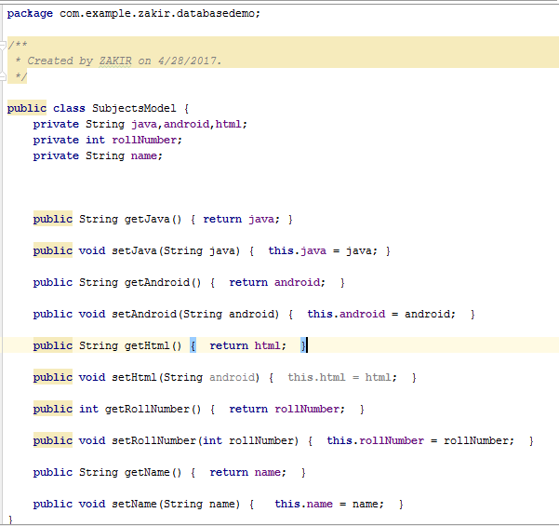
SubjectModel

Slide 35


Sqlite database Example 3

Slide 36

Sqlite database Example 3 continue

Slide 37


Using Cursor

Slide 38



Using Menu xml +menuxml code

Slide 39


MainActivity Java code

Slide 40



DatabaseManager Java code

